Slide 1

AI training group
Weekly Report
Nguyen khai phu – Aug 11 2023

Slide 2
Detect “flickers”
ISP008 foundation
The common terminology for the following bugs are “flickers”
I choose to analyze them individually, since they are distinct from each other (in terms of shapes, colors, directions, possible approaches,...)
2
CISP-1352-A21 - ISP-DOC-STYLETYPE-Templates © Robert Bosch GmbH 2016. All rights reserved, also regarding any disposal, exploitation, reproduction, editing, distribution, as well as in the event of applications for industrial property rights.

Slide 3
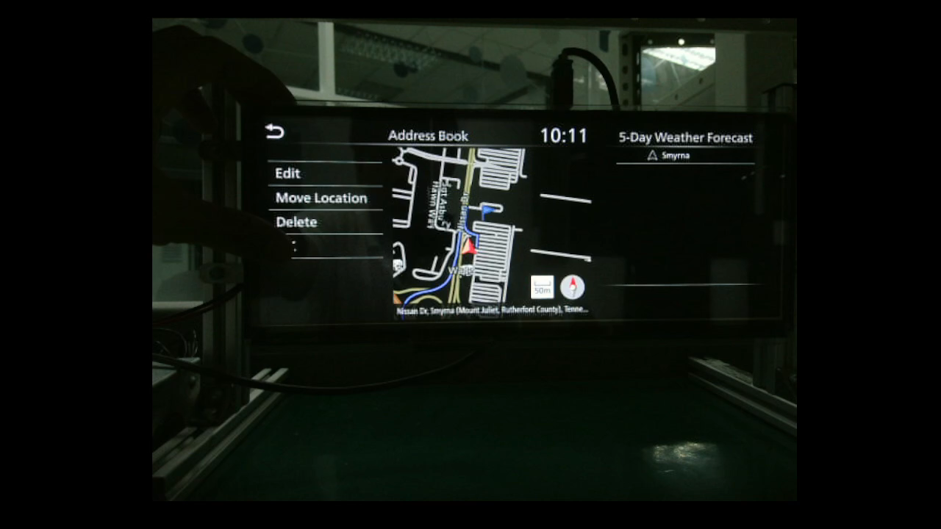
Case 1
ISP008 foundation
2
CISP-1352-A21 - ISP-DOC-STYLETYPE-Templates © Robert Bosch GmbH 2016. All rights reserved, also regarding any disposal, exploitation, reproduction, editing, distribution, as well as in the event of applications for industrial property rights.

Slide 4
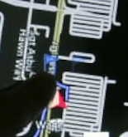
Case 1
ISP008 foundation
Explanation: tester moves the marker (blue flag) to a new location, the animation of removing the old marker does not play “correctly”
Bad lighting conditions, very difficult to recognize
There are other functions that can create markers with different shapes, colors, brightness,...
Extremely niche, probably the most difficult of the 3 cases
2
Internal | C/ISP Krautschneider | 07.12.2017 V1.0
CISP-1352-A21 - ISP-DOC-STYLETYPE-Templates © Robert Bosch GmbH 2016. All rights reserved, also regarding any disposal, exploitation, reproduction, editing, distribution, as well as in the event of applications for industrial property rights.

Slide 5
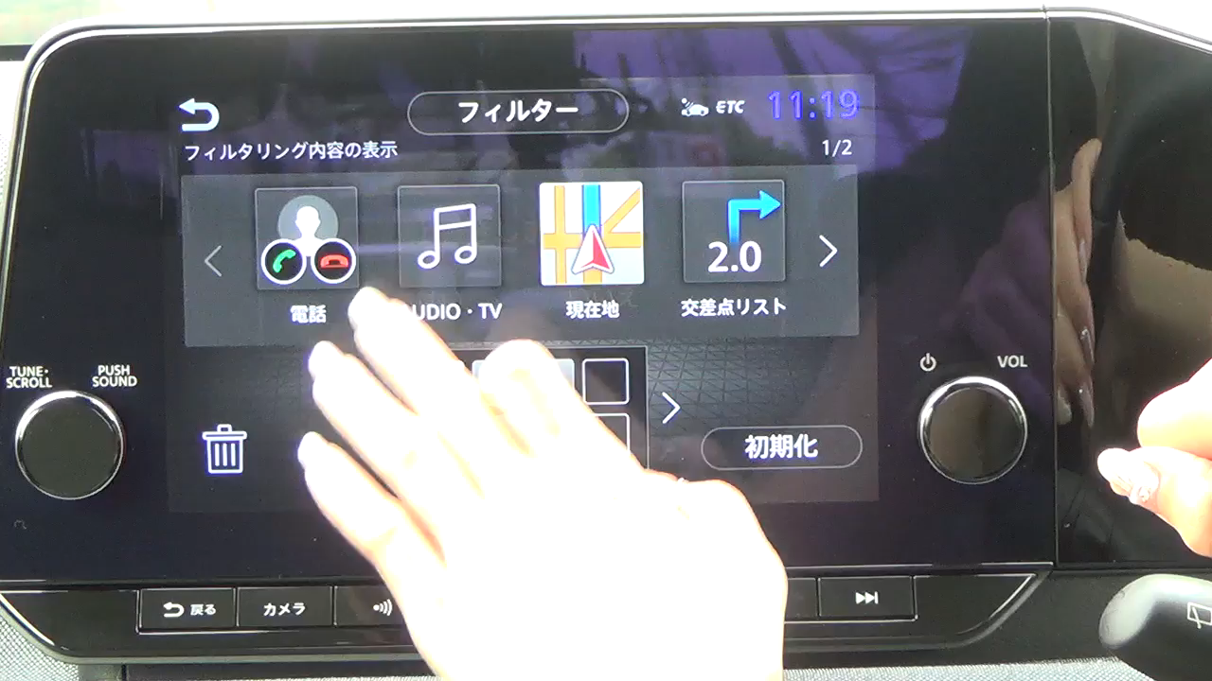
Case 2
ISP008 foundation
2
CISP-1352-A21 - ISP-DOC-STYLETYPE-Templates © Robert Bosch GmbH 2016. All rights reserved, also regarding any disposal, exploitation, reproduction, editing, distribution, as well as in the event of applications for industrial property rights.

Slide 6
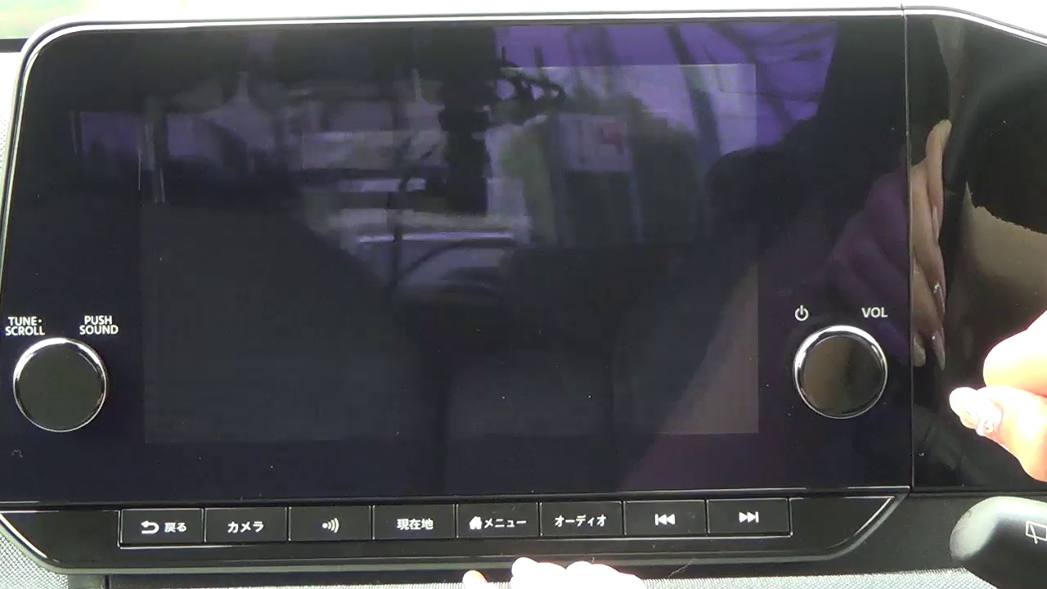
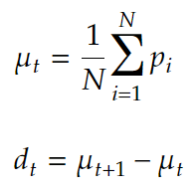
Case 2
ISP008 foundation
Simple solution
Mean:
Difference:
Blink
Affects the whole screen, fairly recognizable
2
Internal | C/ISP Krautschneider | 07.12.2017 V1.0
CISP-1352-A21 - ISP-DOC-STYLETYPE-Templates © Robert Bosch GmbH 2016. All rights reserved, also regarding any disposal, exploitation, reproduction, editing, distribution, as well as in the event of applications for industrial property rights.

Slide 7
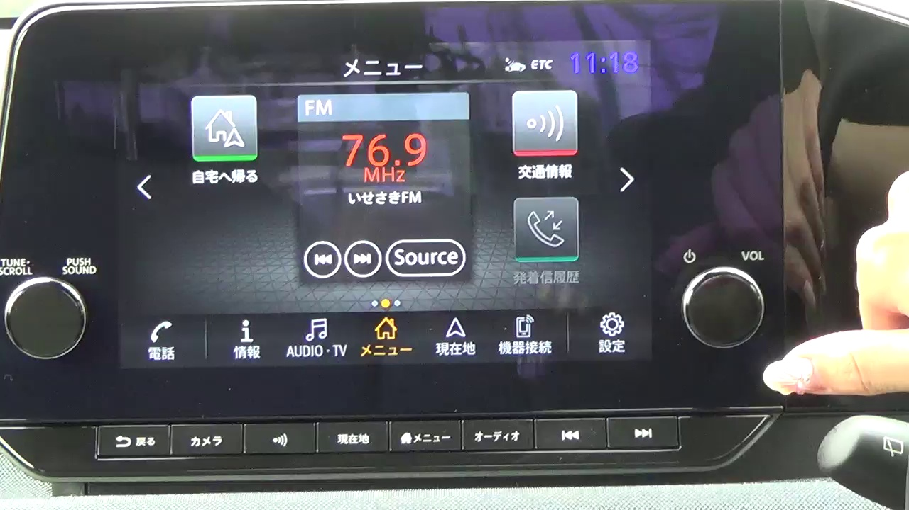


Normal
ISP008 foundation
0.51
-0.15
-0.62
2
Internal | C/ISP Krautschneider | 07.12.2017 V1.0
CISP-1352-A21 - ISP-DOC-STYLETYPE-Templates © Robert Bosch GmbH 2016. All rights reserved, also regarding any disposal, exploitation, reproduction, editing, distribution, as well as in the event of applications for industrial property rights.

Slide 8
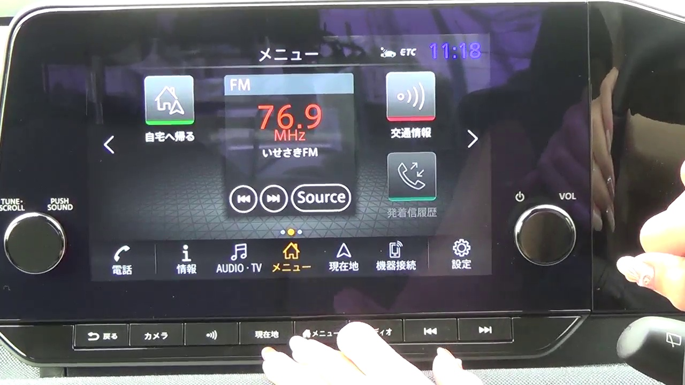
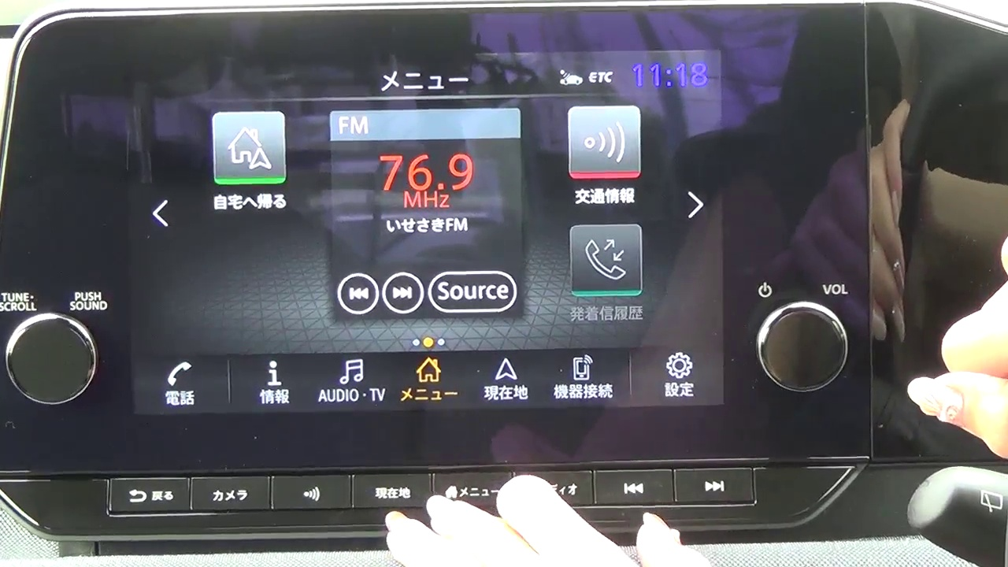
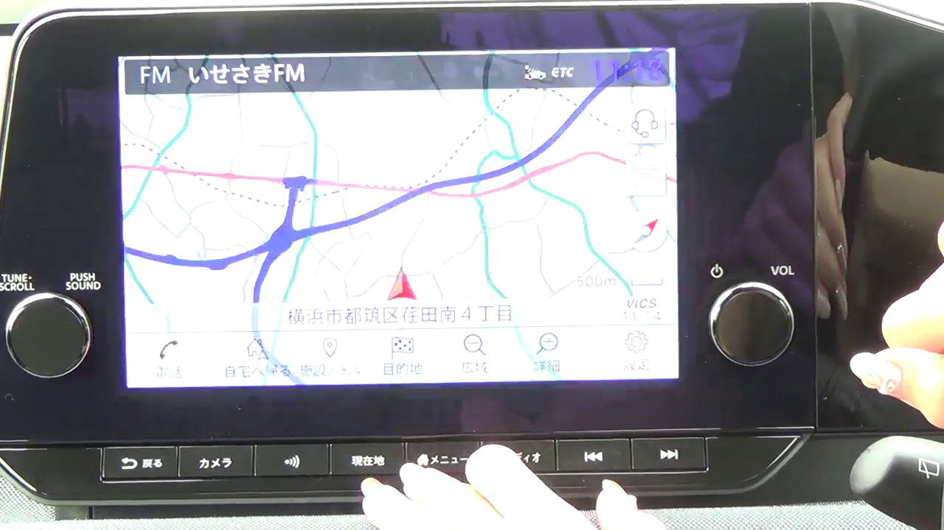

Switch tab
ISP008 foundation
-0.11
52.79
0.19
-0.15
2
Internal | C/ISP Krautschneider | 07.12.2017 V1.0
CISP-1352-A21 - ISP-DOC-STYLETYPE-Templates © Robert Bosch GmbH 2016. All rights reserved, also regarding any disposal, exploitation, reproduction, editing, distribution, as well as in the event of applications for industrial property rights.

Slide 9
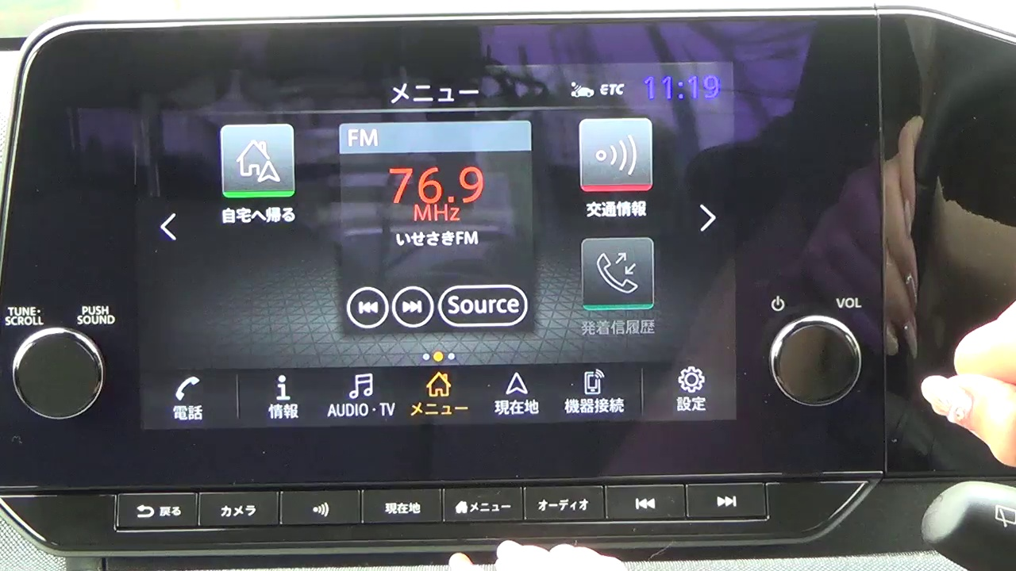

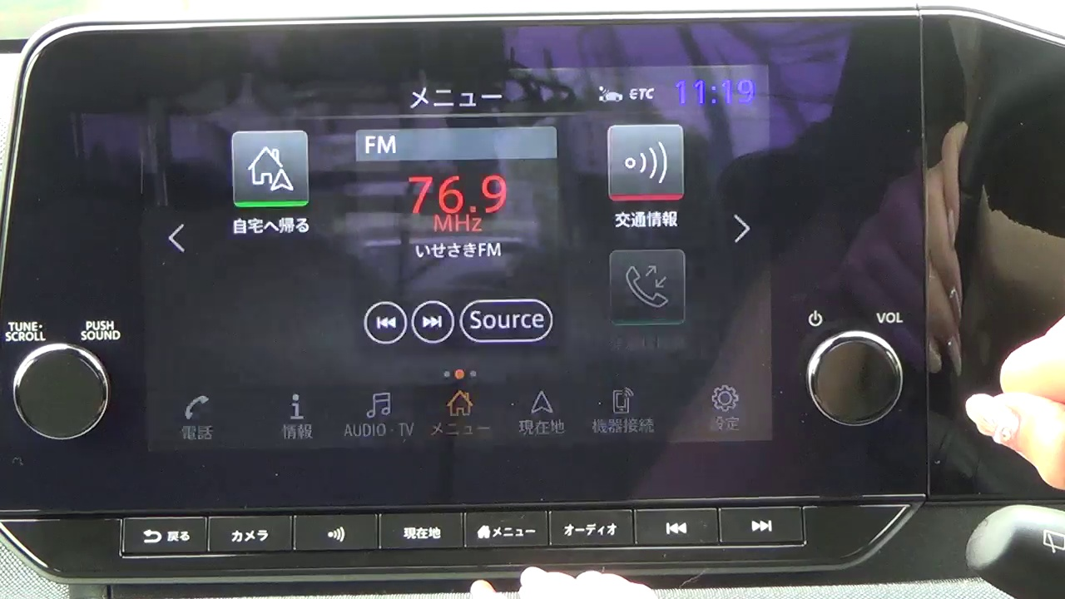

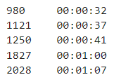
Blink
ISP008 foundation
0.12
-13.97
6.62
7.4
0.27
2
Internal | C/ISP Krautschneider | 07.12.2017 V1.0
CISP-1352-A21 - ISP-DOC-STYLETYPE-Templates © Robert Bosch GmbH 2016. All rights reserved, also regarding any disposal, exploitation, reproduction, editing, distribution, as well as in the event of applications for industrial property rights.

Slide 10
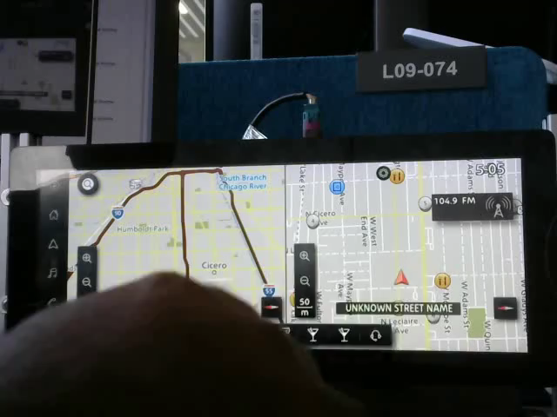

Slide 11
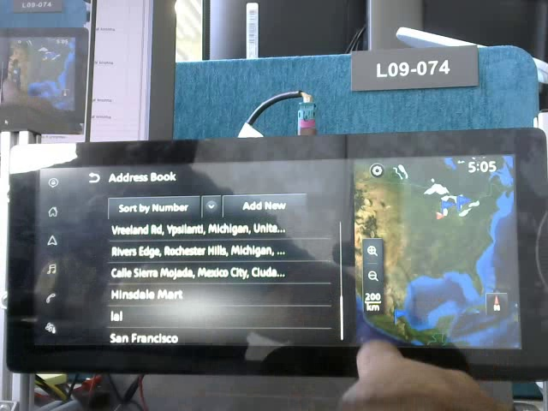
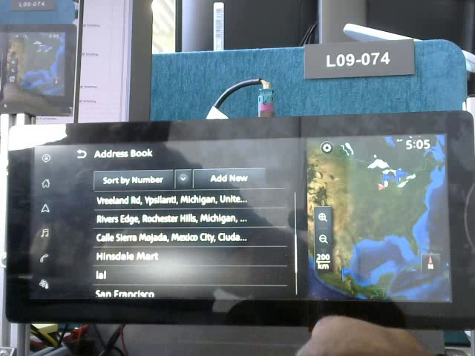
Case 3
ISP008 foundation
The slider doesn’t move “smoothly” corresponding with the finger movement
Cannot identify whether there is a bug or not by just solely based on the information on the screen
2
Internal | C/ISP Krautschneider | 07.12.2017 V1.0
CISP-1352-A21 - ISP-DOC-STYLETYPE-Templates © Robert Bosch GmbH 2016. All rights reserved, also regarding any disposal, exploitation, reproduction, editing, distribution, as well as in the event of applications for industrial property rights.

Slide 12
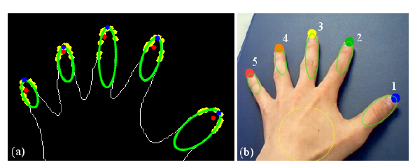
Case 3
ISP008 foundation
Requirements (minimum):
Track fingertips
Track the slider
Challenges:
Light reflection
Tester’s reflection
The arm covers a large part of the screen
The index finger completely covers the slider when the tester interacts with the screen
2
CISP-1352-A21 - ISP-DOC-STYLETYPE-Templates © Robert Bosch GmbH 2016. All rights reserved, also regarding any disposal, exploitation, reproduction, editing, distribution, as well as in the event of applications for industrial property rights.

Slide 13
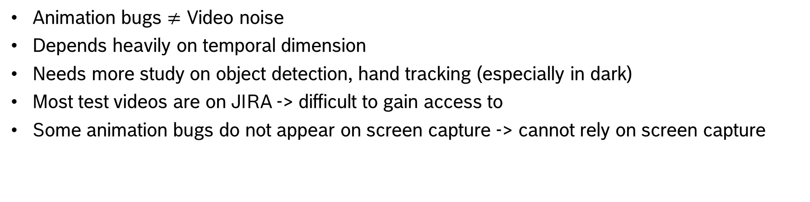
General challenges
ISP008 foundation
Animation bugs $≠$ Video noise
Depends heavily on temporal dimension
Needs more study on object detection, hand tracking (especially in dark)
Most test videos are on JIRA -> difficult to gain access to
Some animation bugs do not appear on screen capture -> cannot rely on screen capture
2
CISP-1352-A21 - ISP-DOC-STYLETYPE-Templates © Robert Bosch GmbH 2016. All rights reserved, also regarding any disposal, exploitation, reproduction, editing, distribution, as well as in the event of applications for industrial property rights.

Slide 14
Approaches
ISP008 foundation
Deep Learning
Need a lot more data
Cannot identify unique bugs with low records
Cannot adapt to new “types” of bugs
Anomaly detection ?
Case-dependent
1 module – 1 type of bug
White-box, relatively easy to spot and fix issues
Put a strain on the process of logical analysis, implementation
Hybrid
Solve empirically easier bugs before running Anomaly detection
2
CISP-1352-A21 - ISP-DOC-STYLETYPE-Templates © Robert Bosch GmbH 2016. All rights reserved, also regarding any disposal, exploitation, reproduction, editing, distribution, as well as in the event of applications for industrial property rights.

